Slide 1


Data Analytics and AI for Graduate Research
Dr. Vu-Hoang Tran

Slide 2
Objectives of the Talk
Understanding Research Lifecycle
Explore key stages in graduate research
Identify Challenges
Discuss common hurdles faced by researchers
AI Tools Overview
Showcase useful AI resources
Integration Tips
How to effectively use AI support

Slide 3





The Graduate Research Process
Topic Selection
Choose relevant, emerging subjects
Data Collection & Analysis
Gather and analyze data
Literature Review
Evaluate key studies
Writing & Publishing
Prepare manuscripts and select journals
Research Design
Develop methods and hypotheses

Slide 4


Stage 1: Topic Selection & AI Support
Key Actions
AI Tools
Align topics with interests
Dimensions.ai: Discover trending topics and funding
Identify research gaps
SciSpace Discover: Interactive idea exploration
Follow field trends

Slide 5
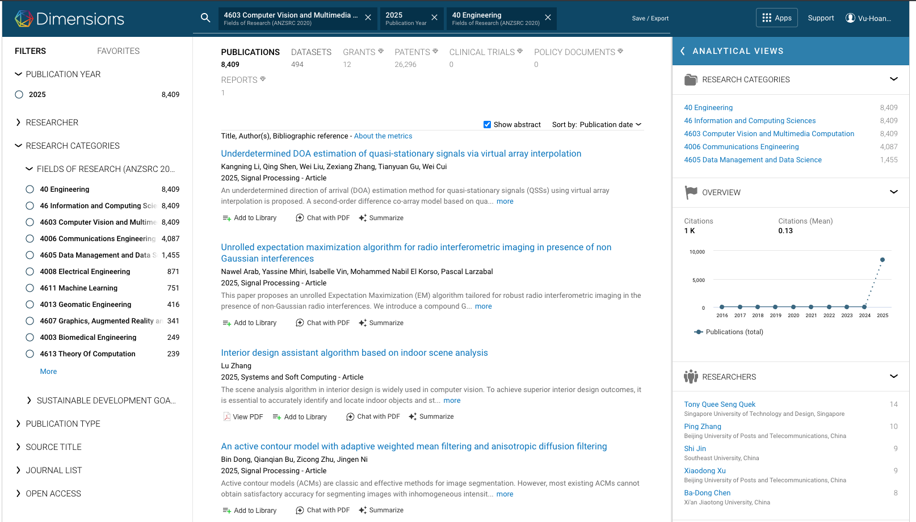
Dimensions.ai

Slide 6
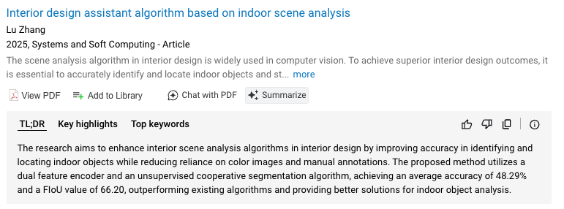
Dimensions.ai

Slide 7
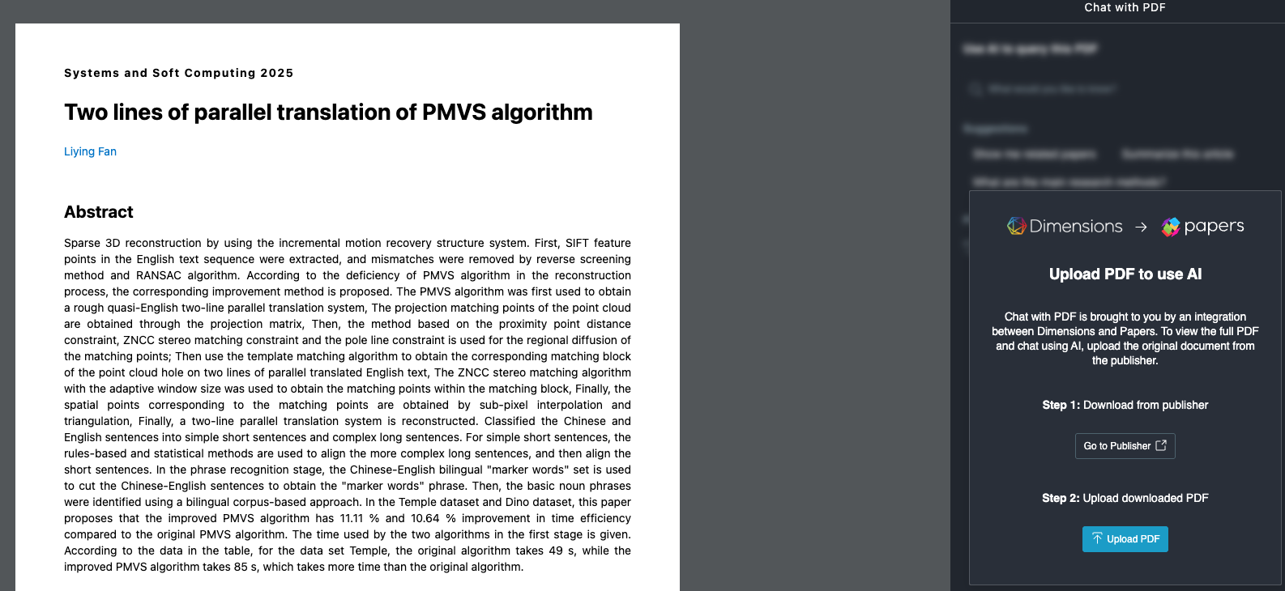
Dimensions.ai

Slide 8
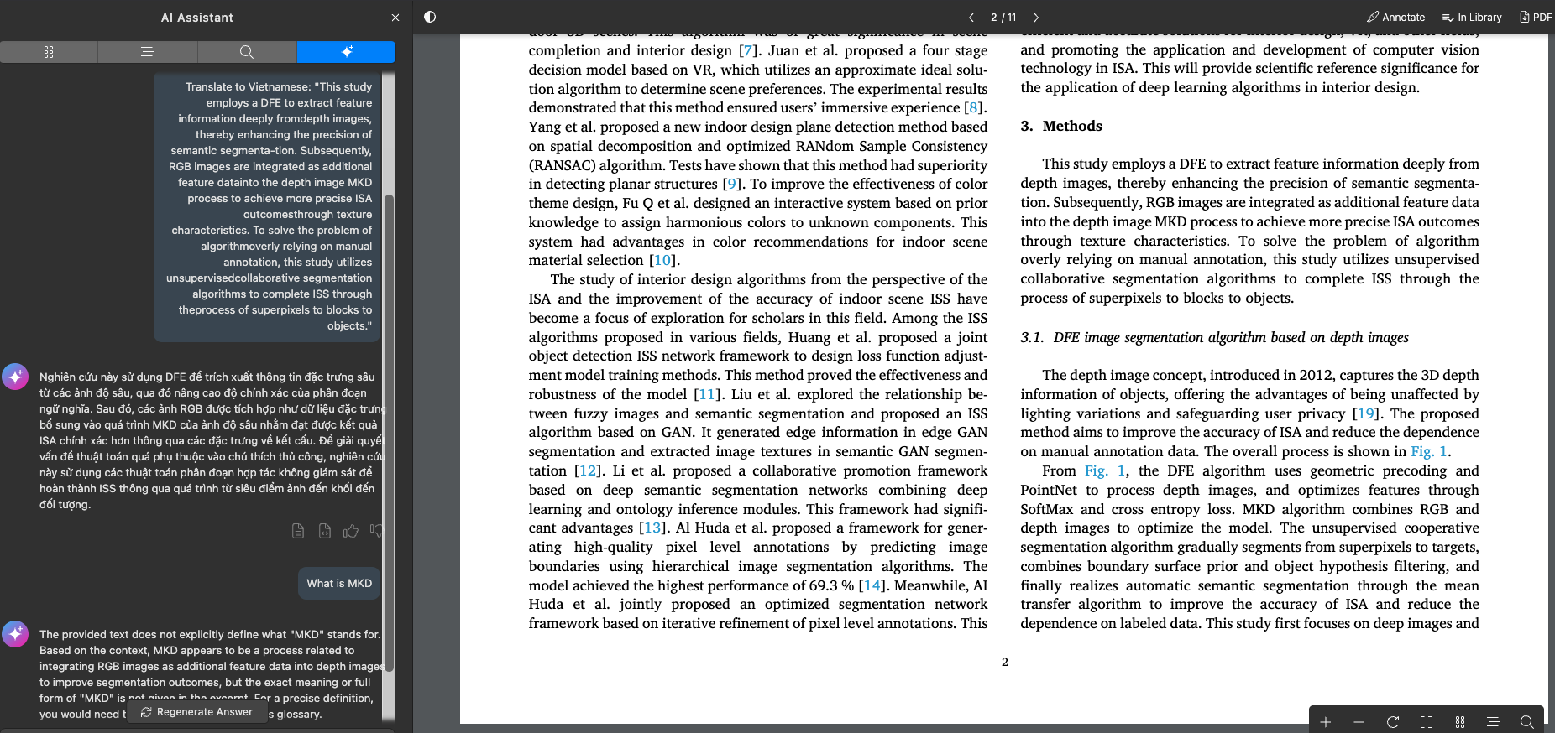
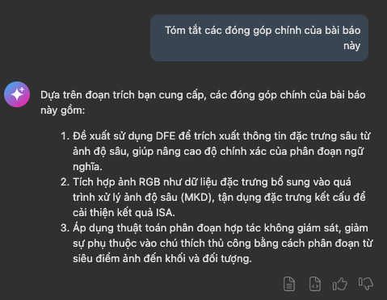
Dimensions.ai

Slide 9
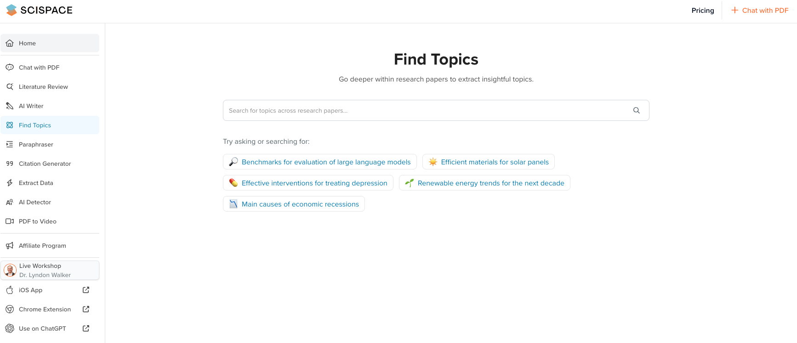
SciSpace Discover

Slide 10
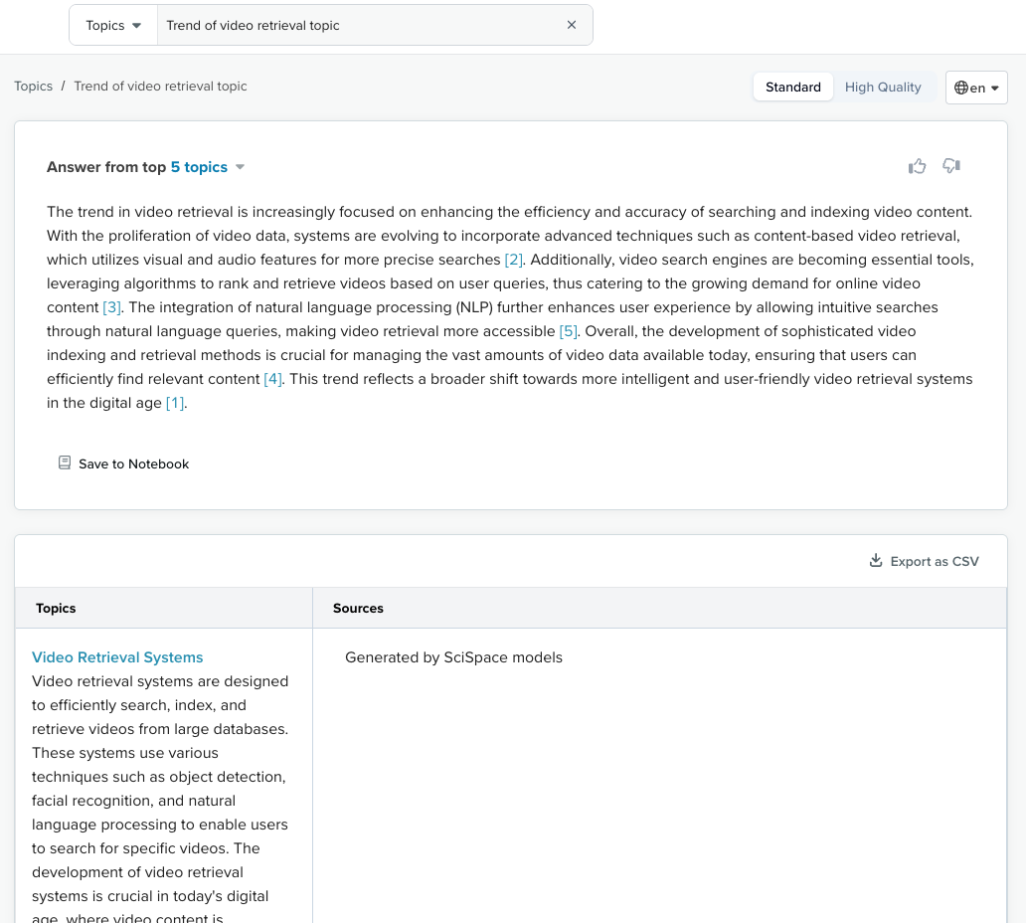
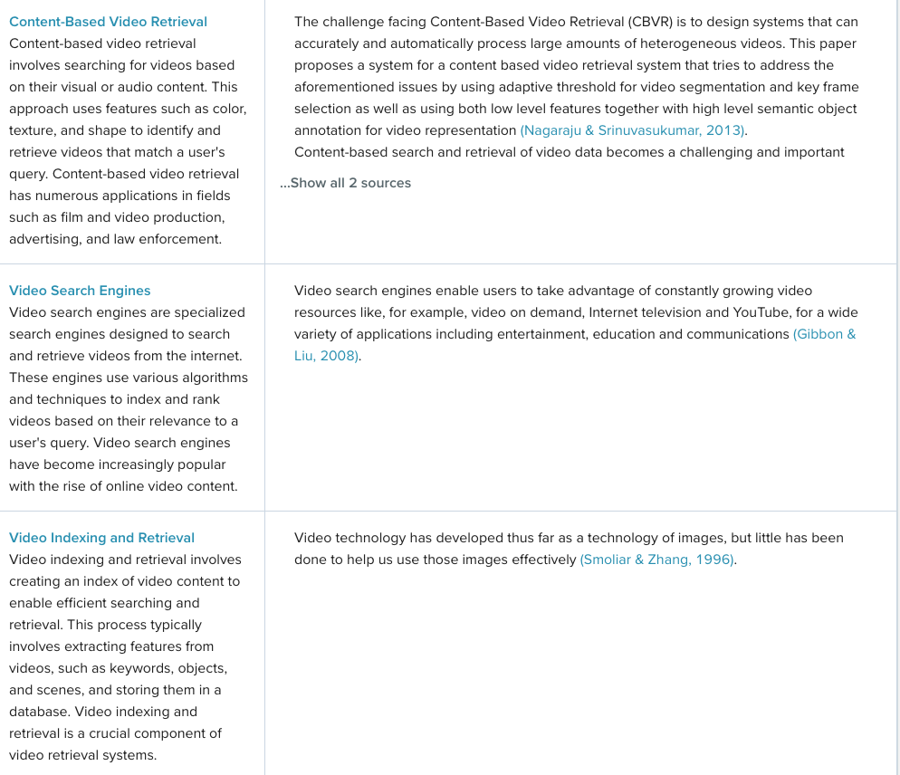
SciSpace Discover

Slide 11

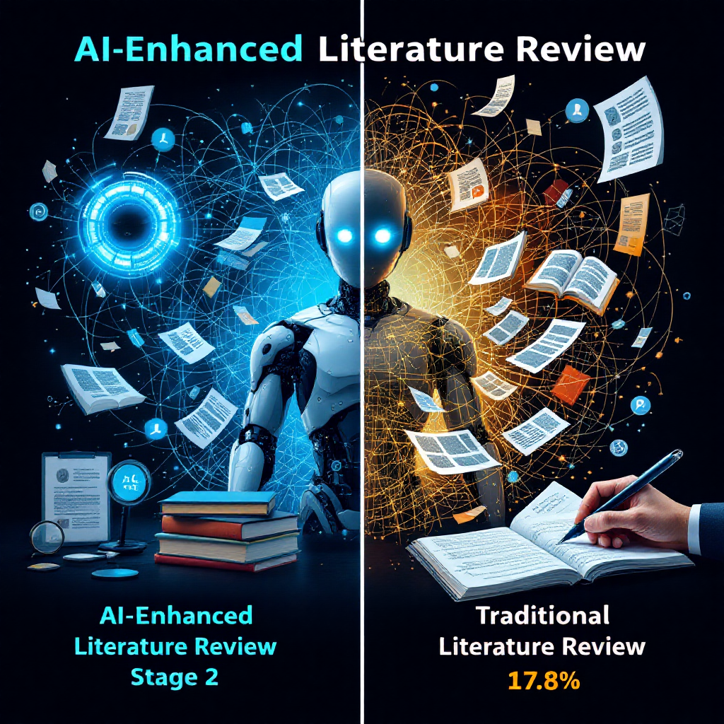
Stage 2: Literature Review & AI Support
Key Actions
AI Tools
Discover Relevant Papers
Analyze Citations
Evaluate Metrics
Connected Papers, Research Rabbit: Visualize citation networks to discover related work
Scite Assistant, SciSpace Discover, Perplexity: Analyze citation contexts to understand research impact
Zotero: collect, organize, annotate, cite, and share research.

Slide 12
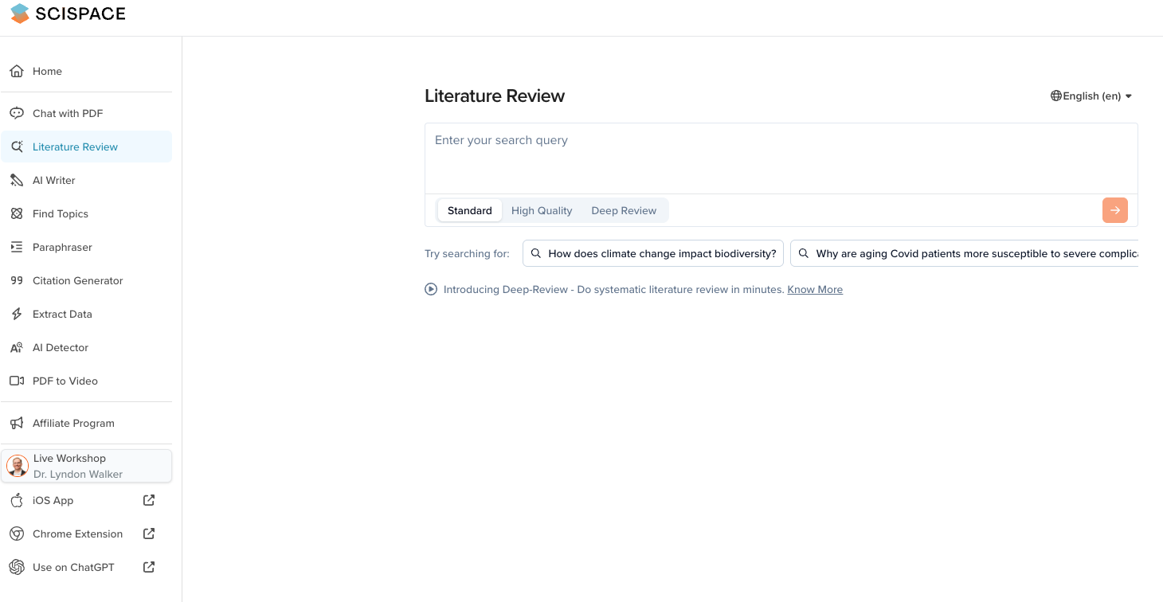
SciSpace Discover

Slide 13
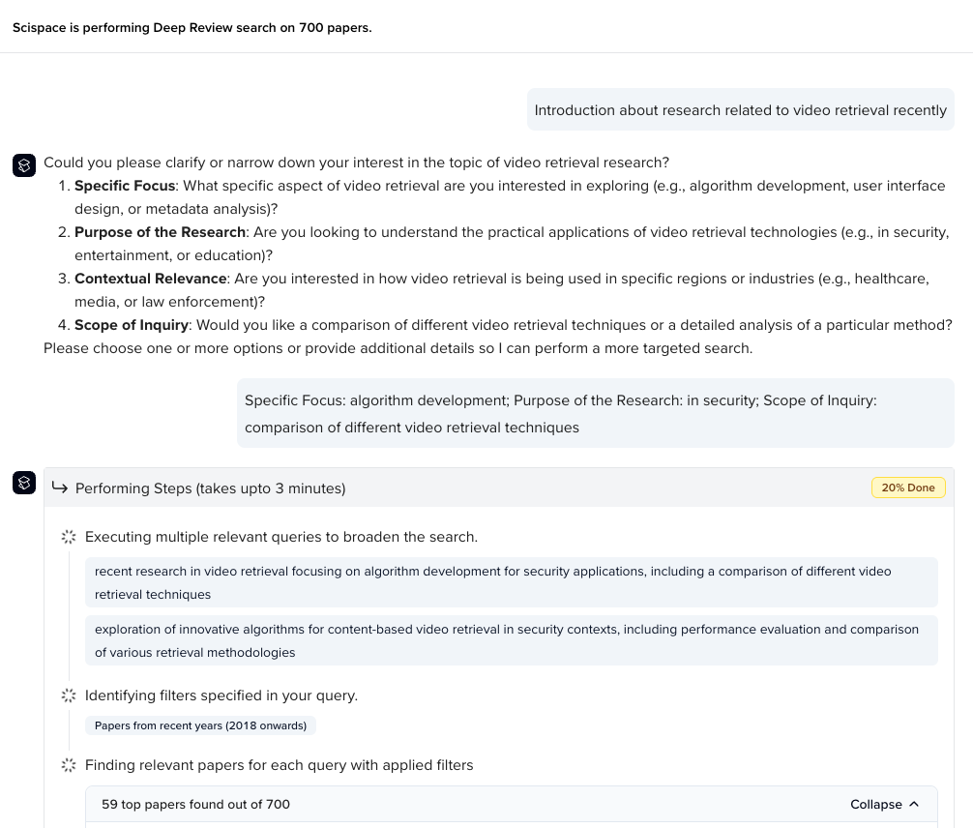
SciSpace Discover

Slide 14
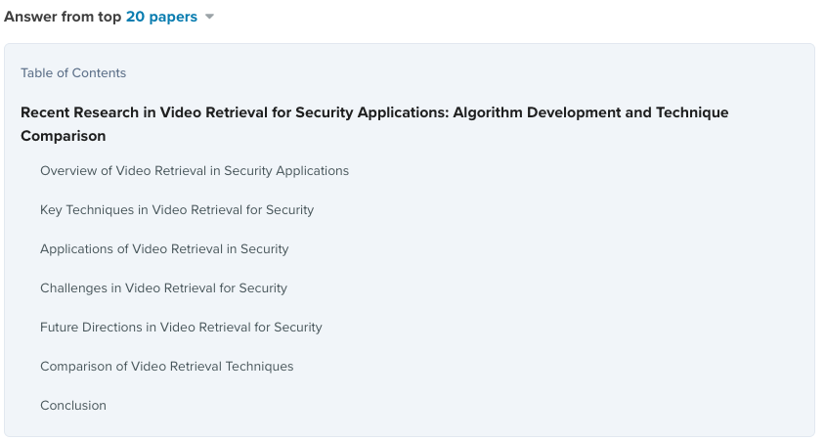
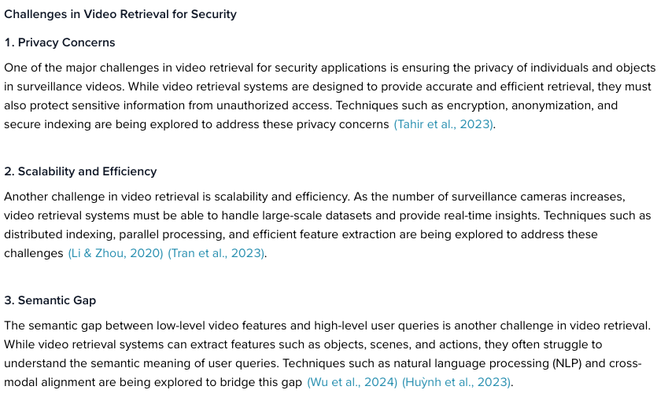
SciSpace Discover

Slide 15
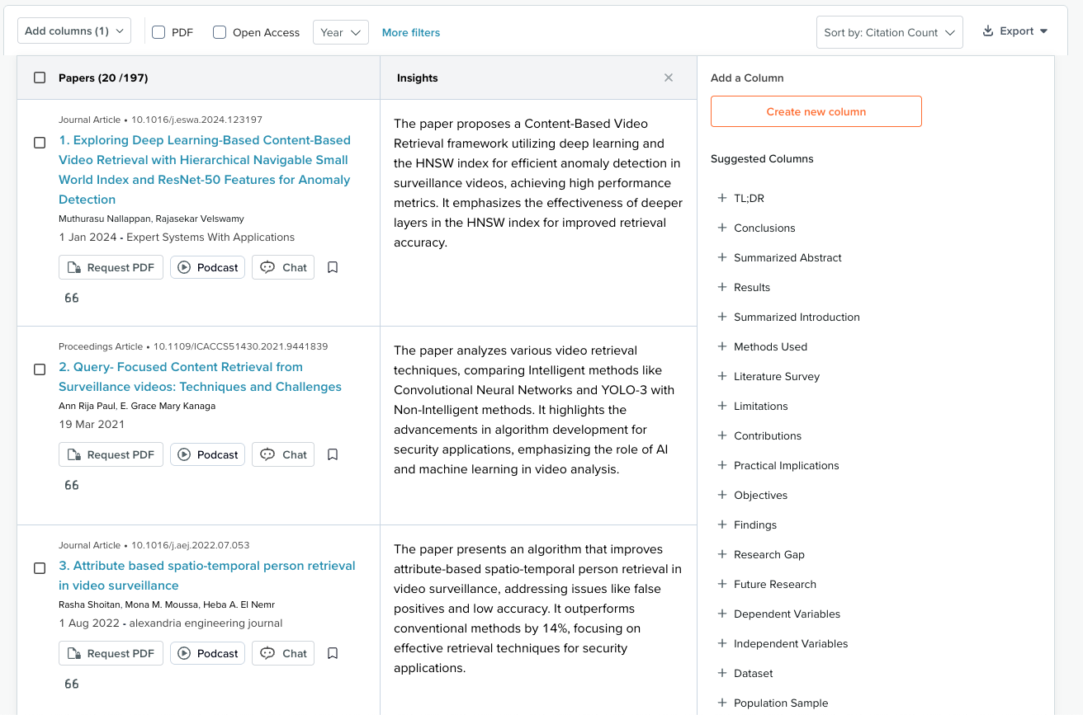
SciSpace Discover

Slide 16
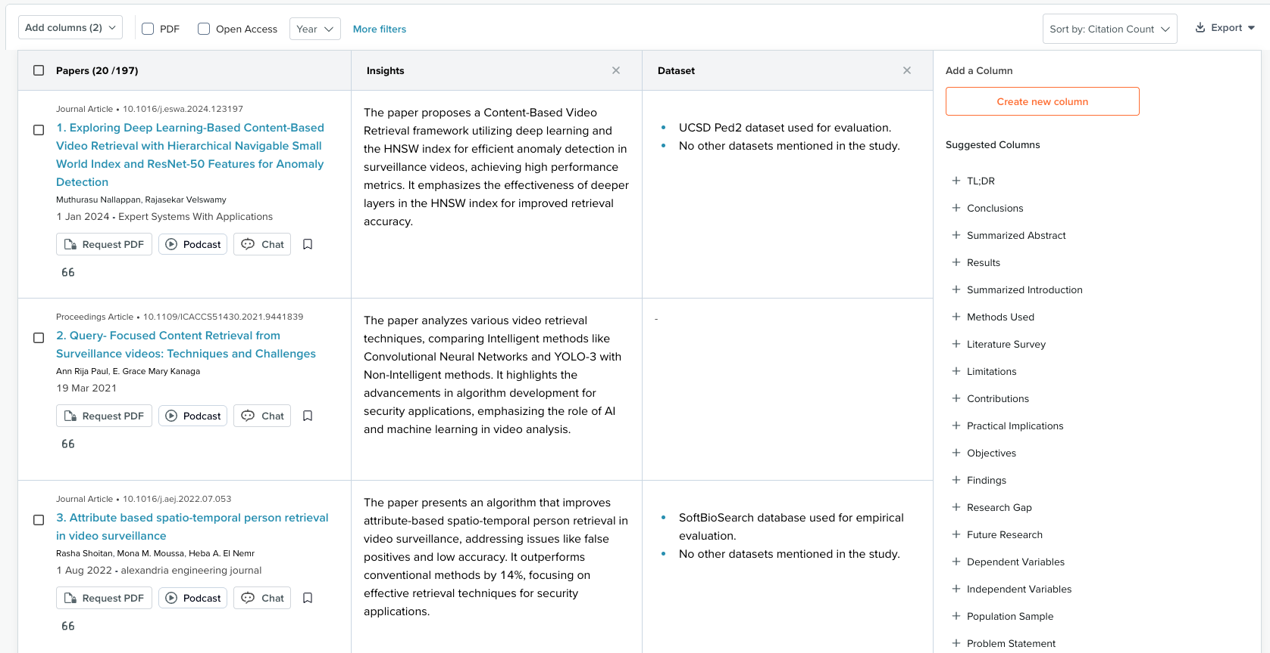
SciSpace Discover

Slide 17
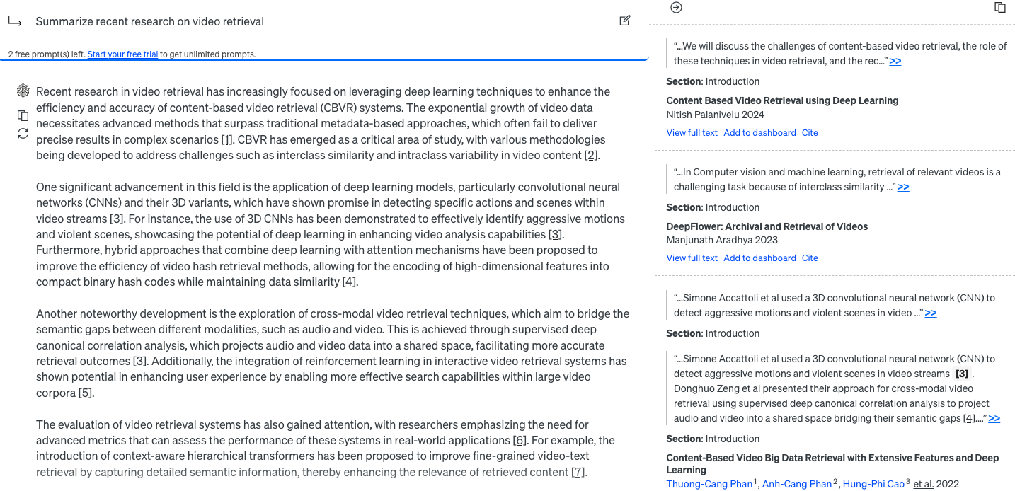
Assistant by Scite

Slide 18
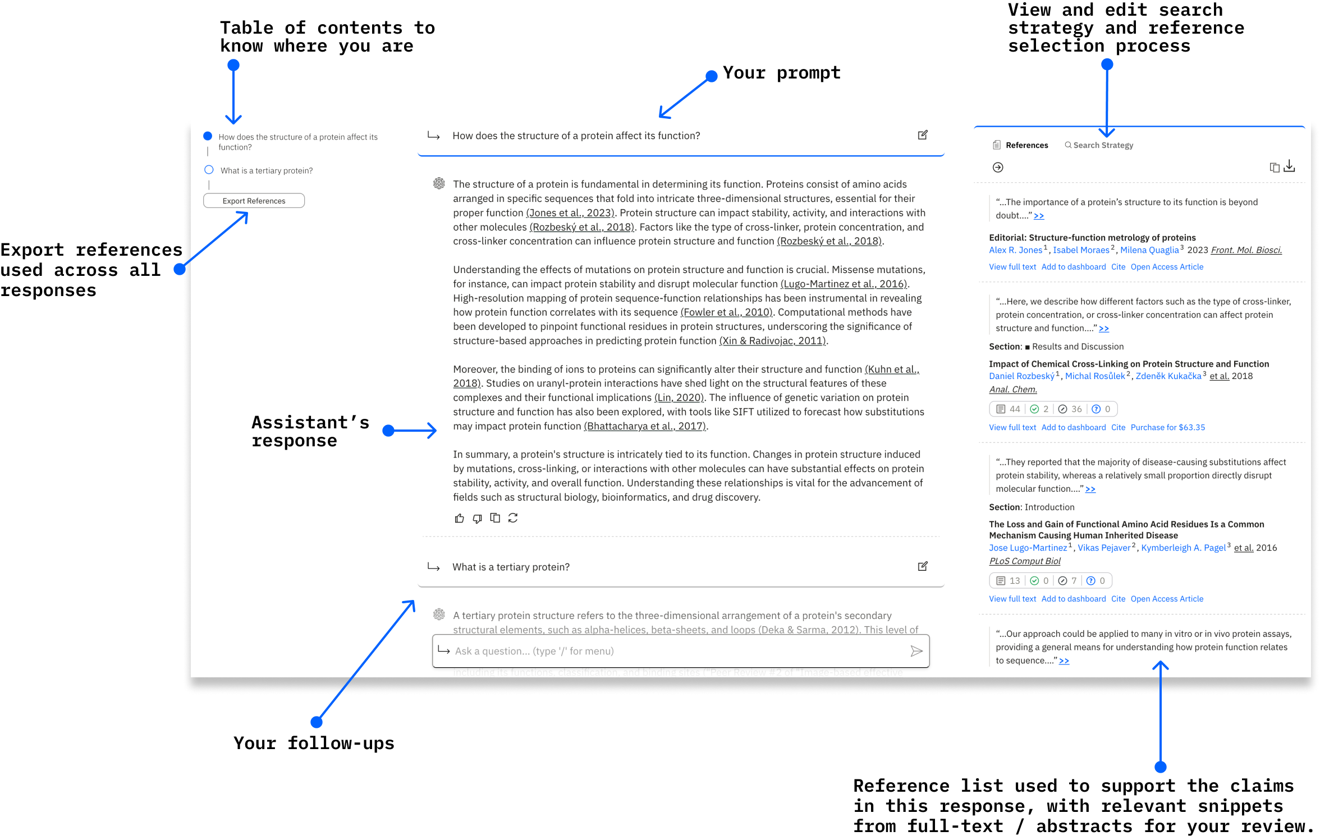

Slide 19
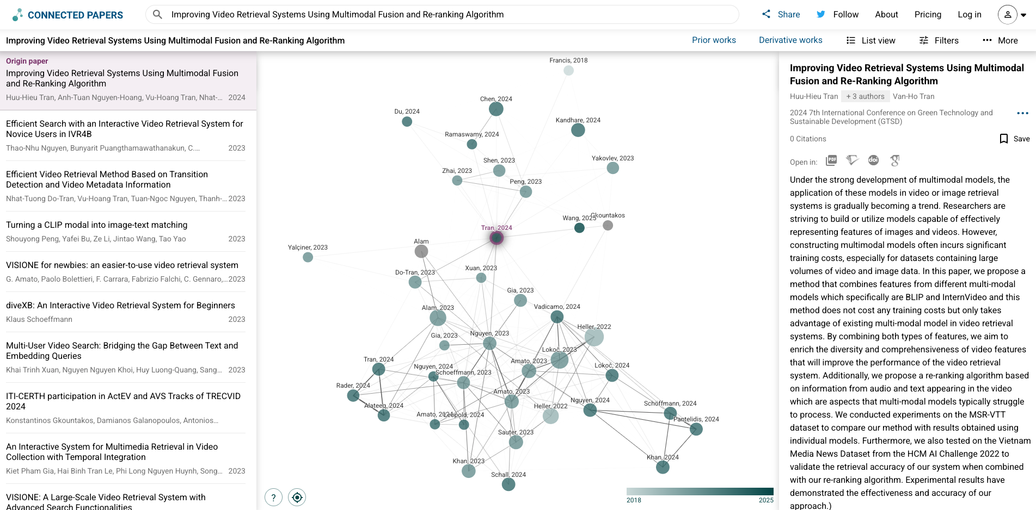
Connected Papers
Notes:
https://www.connectedpapers.com/

Slide 20
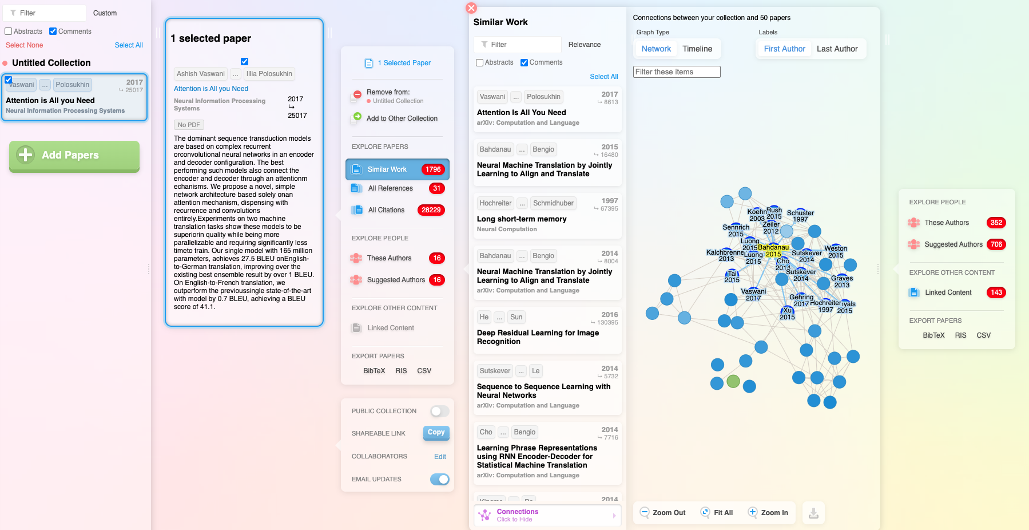
Research Rabbit

Slide 21
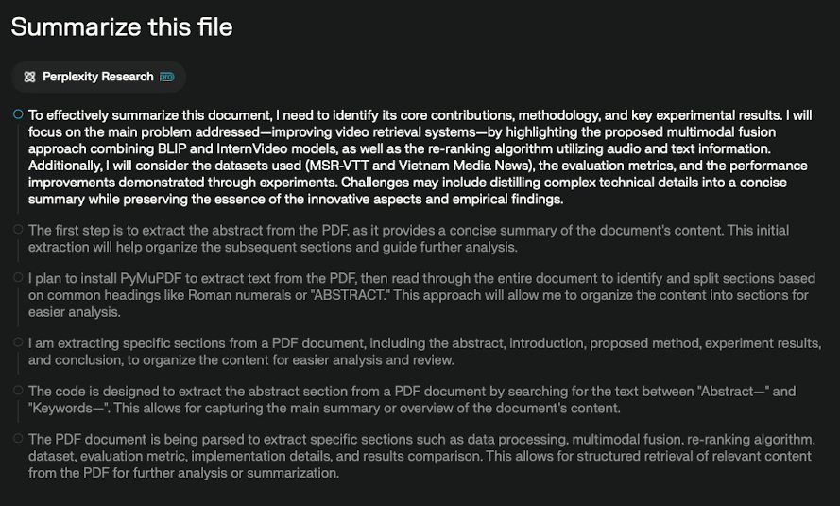
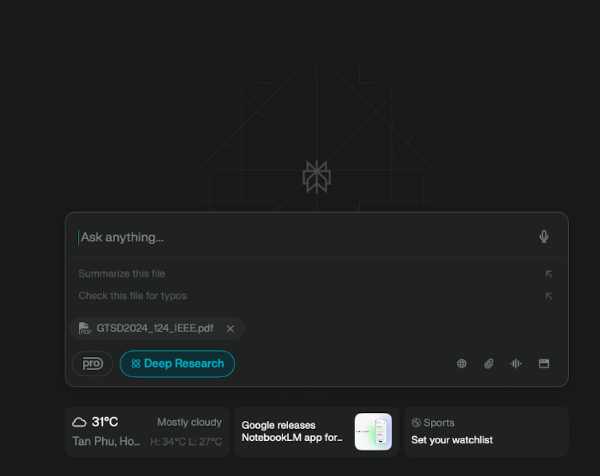
Perplexity

Slide 22
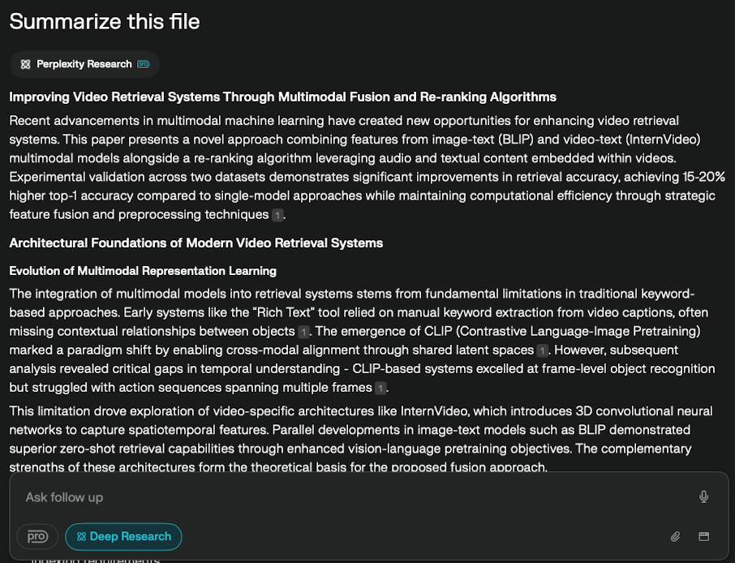
Perplexity

Slide 23
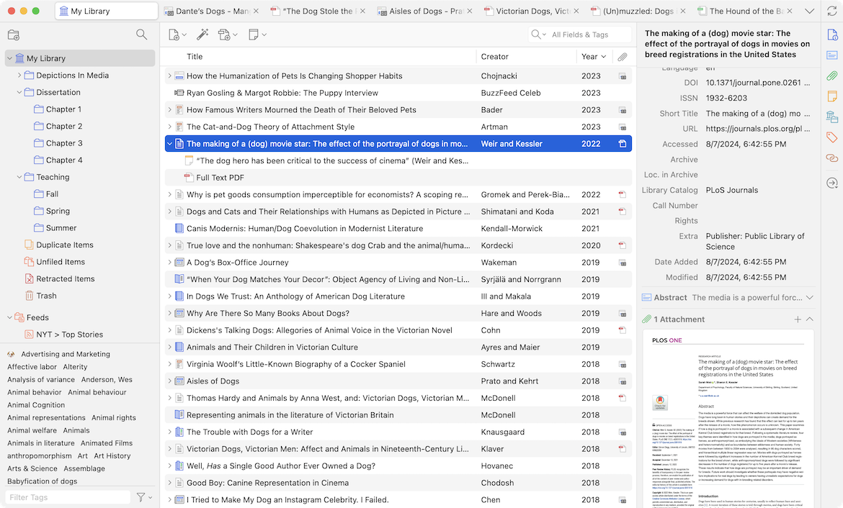
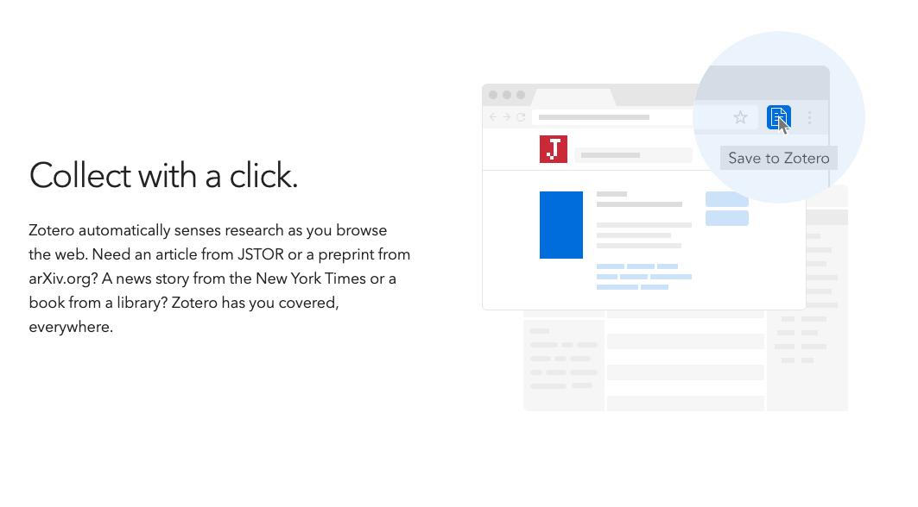
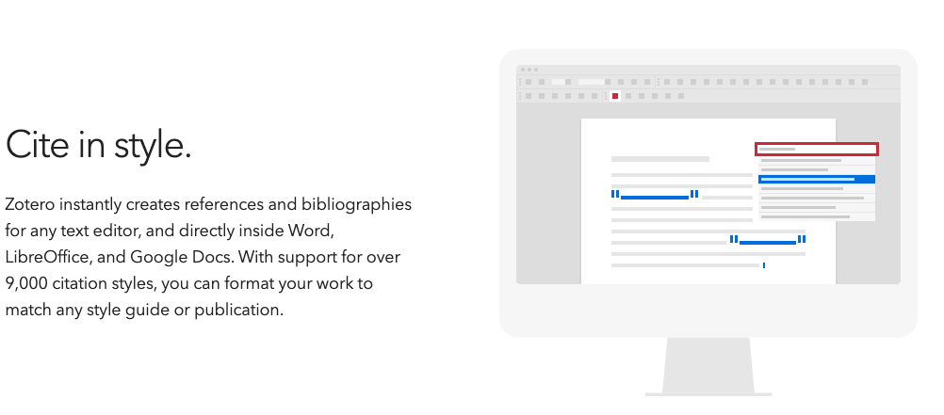
Zotero

Slide 24

Stages 3 & 4: Research Design and Data Analysis
KEY ACTIONS: Define methods & hypotheses Review similar studies with AI Survey/prompt design assistance Use GPT for coding support Draft surveys with AI tools AI helps statistical reasoning | AI TOOLS: Scholarcy Zotero + GPT plugins SciSpace Discover Research Rabbit Elicit.org

Slide 25
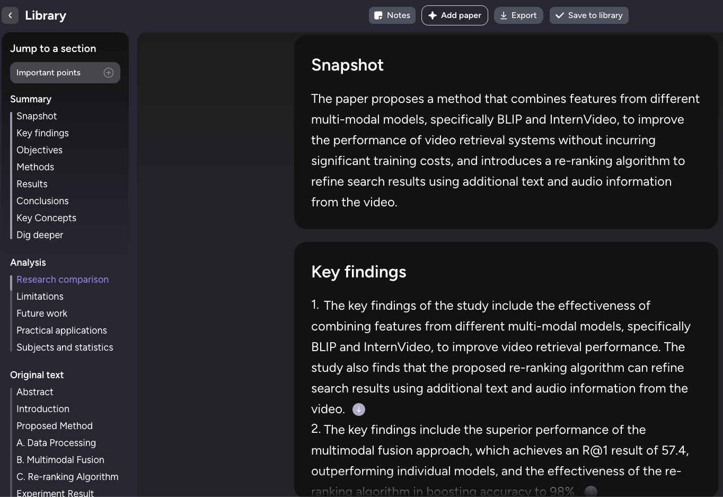
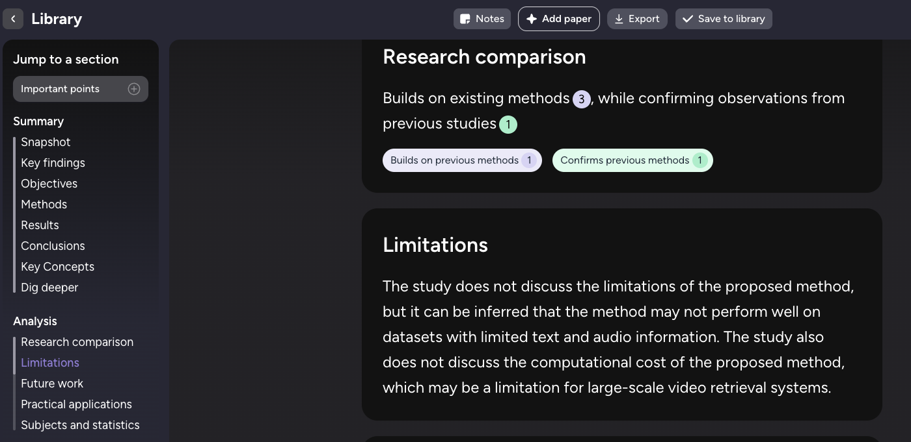
Scholarcy

Slide 26

Stage 5: Writing and Publishing
Key Actions
Draft, revise, and improve clarity of manuscripts
Use AI tools for grammar and style assistance
Find suitable journals for submission
AI Tools
Grammarly - grammar and style improvement
Jenni.ai - AI writing assistant
SciSpace Discover – All-in-One AI tools
Journal Finder - discover appropriate journals

Slide 27
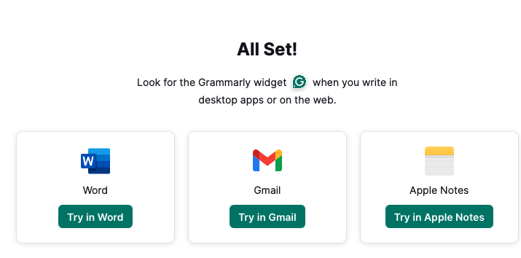
Grammarly

Slide 28
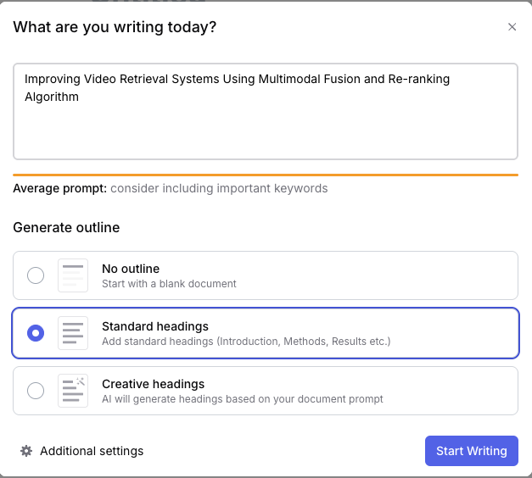
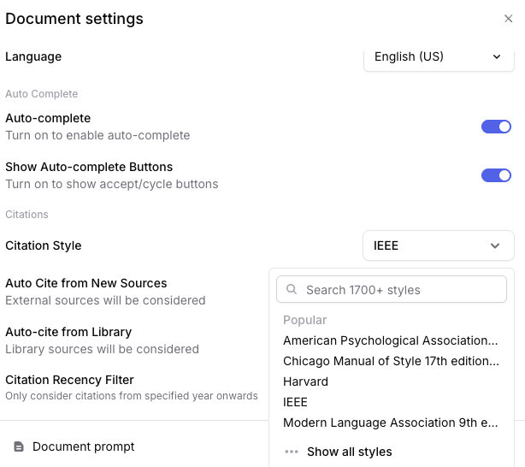
jenni.ai

Slide 29
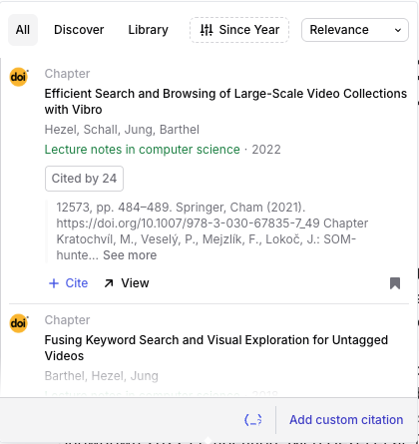
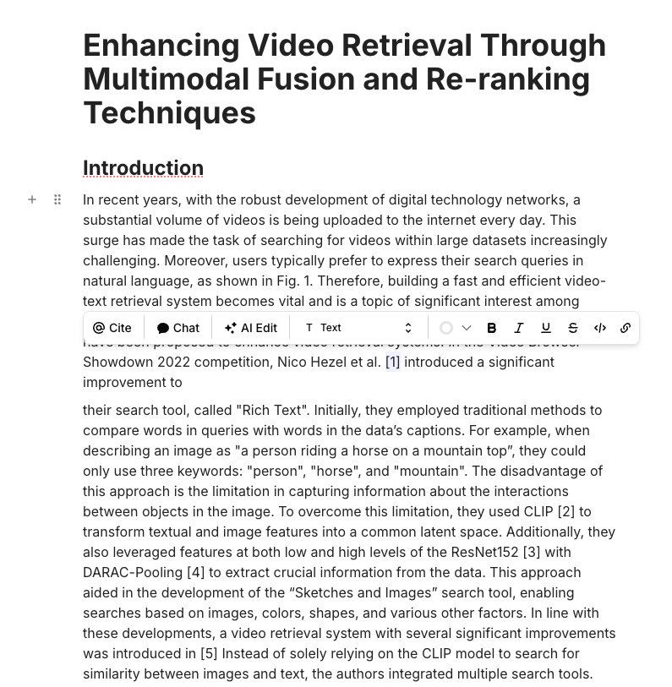
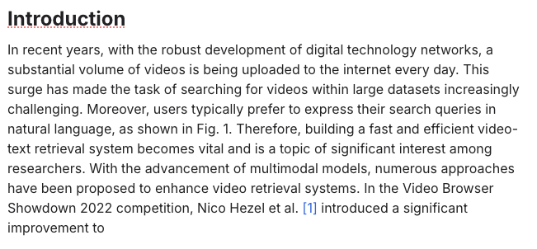

jenni.ai
Click

Slide 30
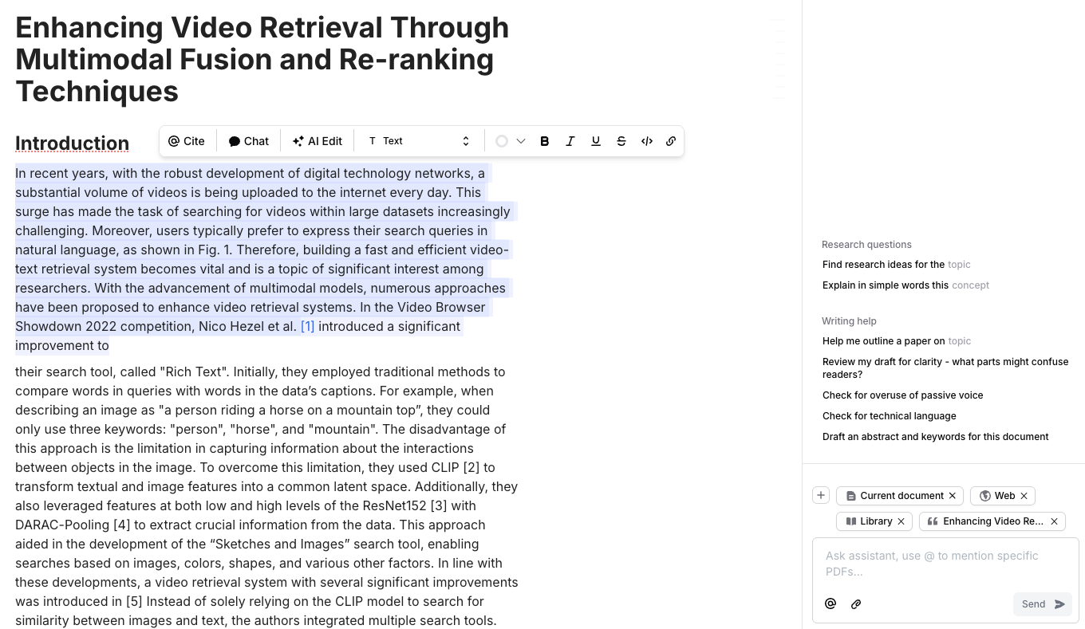
jenni.ai

Slide 31
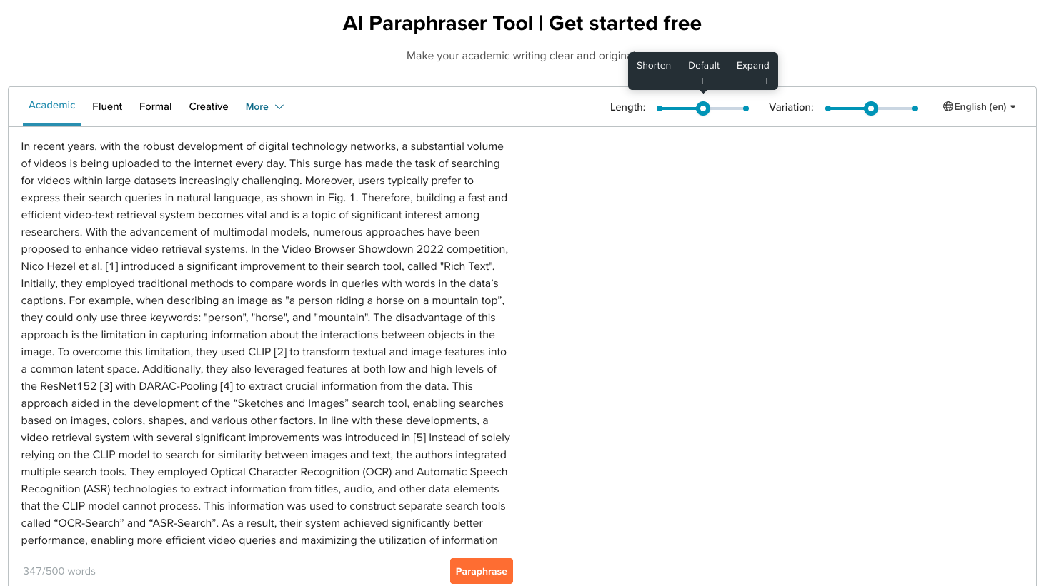
SciSpace Discover

Slide 32
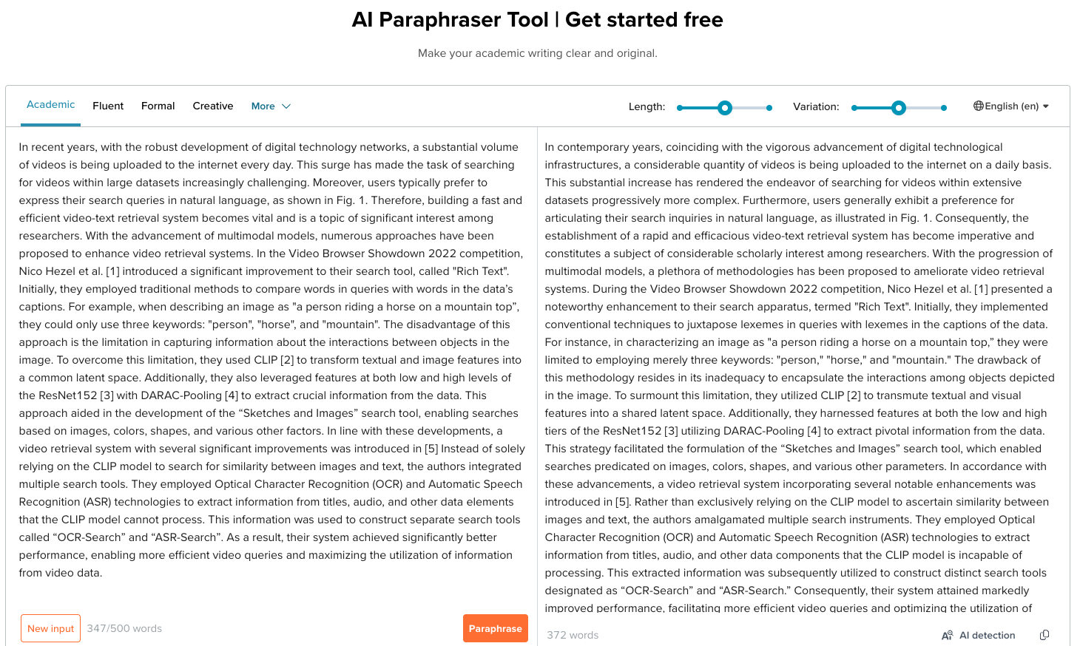
SciSpace Discover

Slide 33
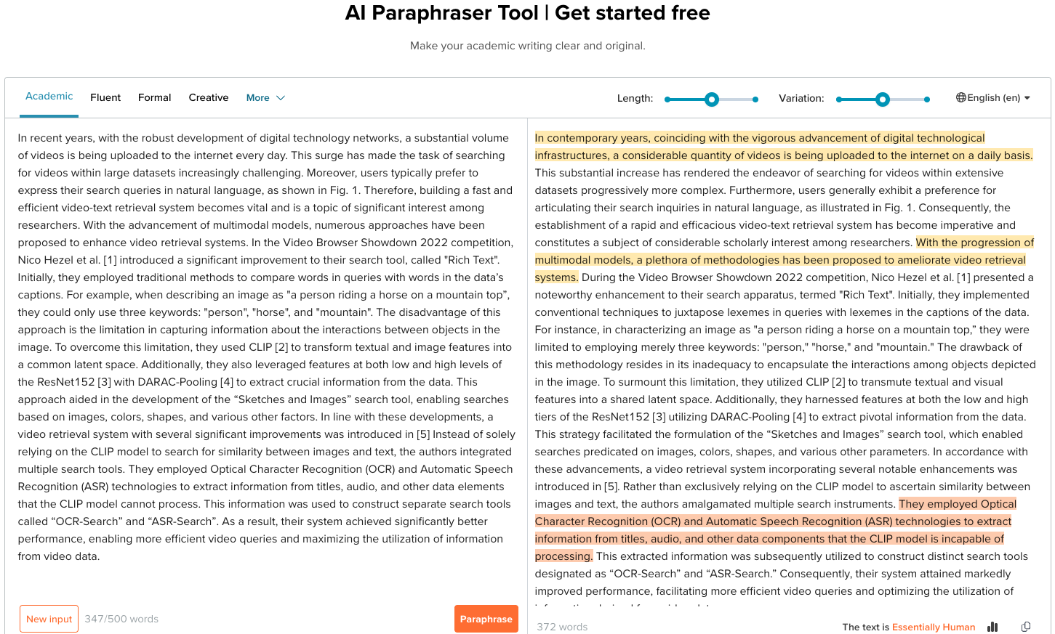
SciSpace Discover

Slide 34
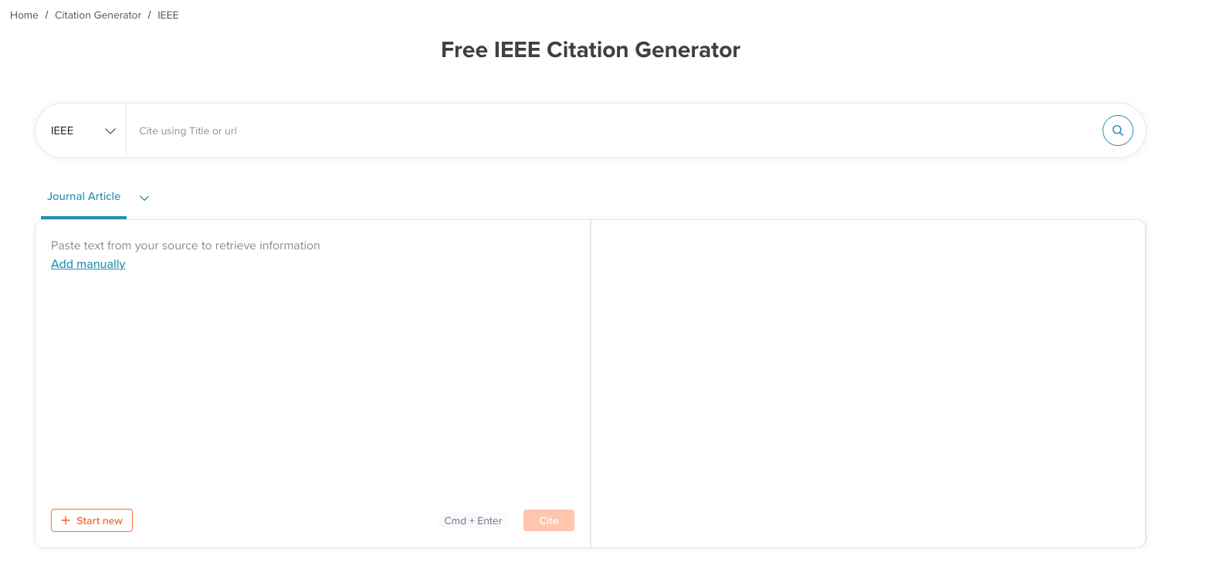
SciSpace Discover

Slide 35
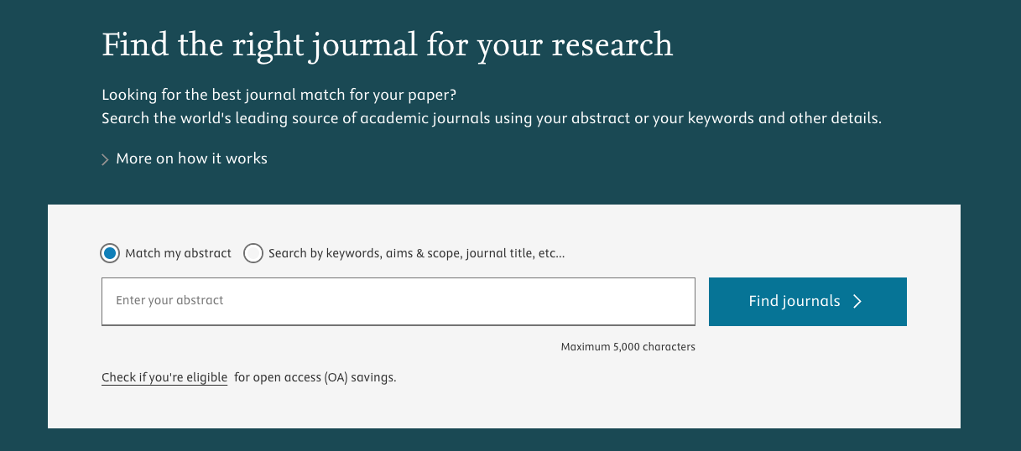
Journal Finder

Slide 36
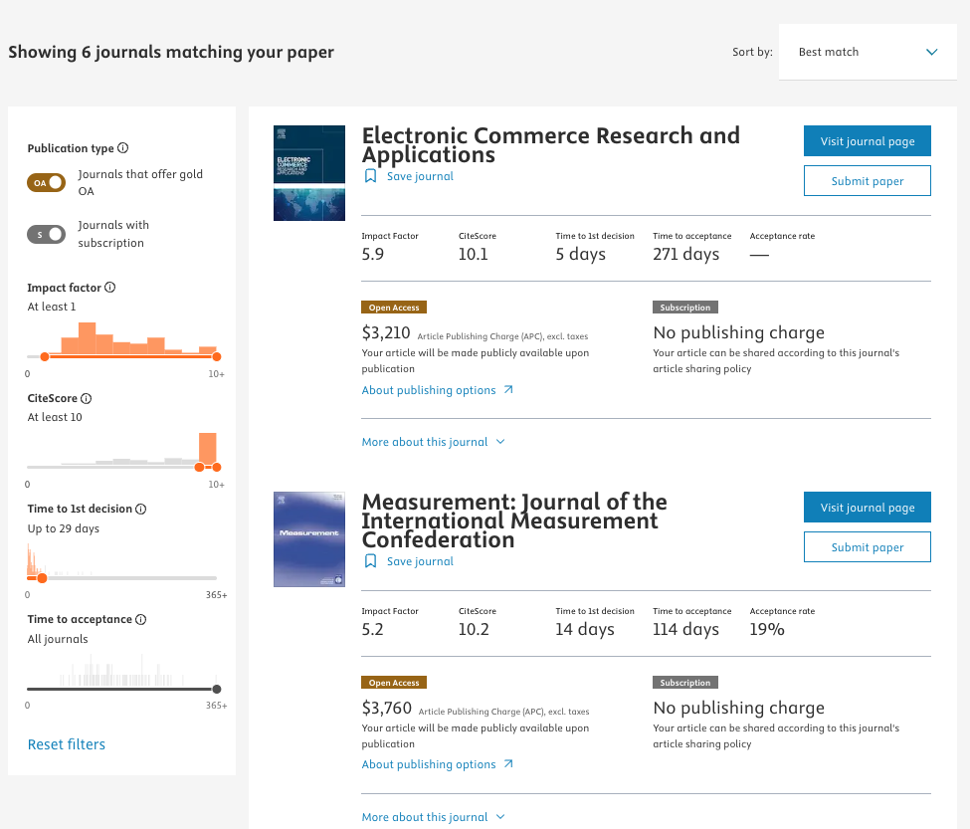
Journal Finder

Slide 37
Overview AI Tools
Tool | Purpose | Stage Used
Dimensions.ai | Topic trends, funding, citations | Topic, Lit. Review
Connected Papers Research Rabbit | Paper visualization | Literature Review
Zotero | collect, organize, annotate, cite, and share research | Literature Review, Writing
Scite Assistant | Citation context, QA | Literature, Methodology
Scholarcy | Summarize, analyze and organize your research | Literature, Methodology
Perplexity | Conversational search | All stages
Grammarly | Grammar, clarity, tone | Writing, Presentation
Jenni.ai | AI co-writer | Writing
Journal Finder | Journal suggestions | Writing & Publishing
SciSpace Discover | All-in-one AI tools for students and researchers. | All stages

Slide 38




Integrating AI into Your Workflow
Use AI Early Spark ideas and structure your research efficiently. | Use AI Ethically Always cite sources and avoid fabrications. | Combine Tools Leverage multiple AI tools for best results. | Iterate Treat AI as a partner, not the final authority.

Slide 39

Best Practices and Pitfalls
Critically Evaluate
Cross-Check Outputs
Stay Focused on Purpose
Avoid Blind Copying
Don’t Substitute Understanding
Question and verify AI suggestions carefully.
Confirm findings using several AI tools, resources.
Use AI aligned with your research objectives.
Don’t accept AI content uncritically.
Use AI as a tool, not a replacement for insight.

Slide 40



Thank You for Your Listening! Q&A
Stay Connected
Follow up for resources and AI research updates.
Keep Exploring
Integrate AI tools thoughtfully in your research.
Continue Learning
Embrace AI as a partner in academic growth.

